Slide 1
Sprint Review 9
The Brewing Game
(Mash It!)
27th March 2026
Gracjan Blazejowski
Bruce Gray
Marta Grazia
Sergio Eneide
Aaron Stevens

Slide 2
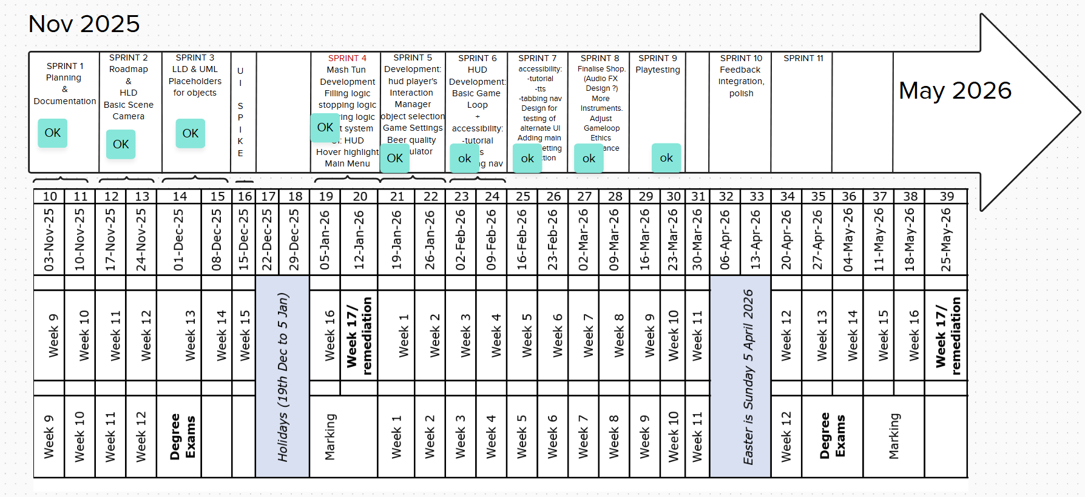
The Brewing Game - Project’s Roadmap

Slide 3
Sprint work
Ethics clearance
  Observation playtesting document
  Consent form
  Participant Information Sheet
Test Build
Playtests
  2 session with engineering UHI students
  1 session with computing UHI student
  2 sessions with non UHI testers
Marta G

Slide 4
Ethics and testing methodology
Referring to User and task analysis document
User personas helped identify testers
Tasks helped identify test cases and application flow
  Task 1: complete a brew
  Task 2: brew again
  Task 3: purchase instrument and brew again
  Task 4: complete the game
Marta G

Slide 5
Observation Testing
Observe user interface with the software
Minimal guidance
Questions and comments are addressed and replied to
Note taking
Final chat with participant for additional thoughts and feedback
Marta G

Slide 6
Extracting feedback from notes
Noted common bugs experienced by testers
Qualitatively assessing User Experience from how users interfaced with the game
Direct feedback from users noted
Marta G

Slide 7
Bugs bugs bugs & Swatter
Found the root cause of the “Settings menu bug”
Found a text sizing bug in the shop menu
Found a necessary tutorial improvement
Gracjan B

Slide 8
Up Next
Sprint planning
Translating feedback and testing notes into tickets
Red Amber Green (RAG) analysis of tickets/bugs
Feedback integration cycle
Marta G

Slide 9
Thank you!
The Brewing Game’s Team

